Slide 1

A+ Guide to Managing and Maintaining your PC, 6e
Chapter 9
Installing and Supporting I/O Devices

Slide 2
Objectives
Learn about the general approaches you need to take when installing and supporting I/O devices
Learn about keyboards
Learn how to work with the mouse and other pointing devices
Learn about monitors and video cards and how they relate to the system

Slide 3
Objectives (continued)
Learn how to use ports and expansion slots for add-on devices
Learn how to troubleshoot I/O devices, including keyboards, pointing devices, and video

Slide 4
Introduction
Range of I/O devices will be presented
Basic I/O devices
The keyboard and mouse
Advanced I/O devices:
Video, peripheral devices, and expansion cards
Skills to acquire:
Installation
Support
Troubleshooting

Slide 5
Basic Principles to Support I/O Devices
Internal devices: hard drives, CD drives, Zip drives
External devices: keyboards, monitors, mice
Connected using port off motherboard or expansion card
Fundamental principles and concepts:
Every I/O device is controlled by software (device driver)
Manufacturer is best guide for installation and support
Some devices are manipulated with application software
Problems can sometimes be solved with driver updates
Learning about I/O devices is a moving target

Slide 6
Working with Keyboards
Types of design: traditional straight and ergonomic
Keyboards differ in the feel of the keys as you type
Example 1: Degrees of resistance offered by key
Example 2: Sound made by contact with keys
Carpal tunnel syndrome (CTS):
Type of repetitive stress injury (RSI)
Caused by repetitive non-ergonomic data entry
Preventing CTS:
Keep your elbows at about keyboard level
Keep your wrists straight and higher than your fingers

Slide 7
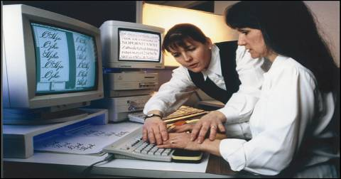
Figure 9-2 Keep wrists level, straight, and supported while at the keyboard

Slide 8
How Keyboard Keys Wok
Ways keys make contact: foil contact, metal contact
Pressing a key on a foil-contact keyboard
Two layers of foil make contact and close a circuit
Spring under keycap raises the key after it is released
Pressing a key on a metal-contact keyboard
Two metal plates make contact
A spring raises the key when it is released
Comparing feel of keystrokes
Metal-contact keyboard gives more definitive contact

Slide 9
Keyboard Connectors
Four methods keyboards use to connect to a PC
DIN connector (mostly outdated now)
PS/2 connector (sometimes called a mini-DIN)
USB port
Wireless connection
Keyboard connector adapter:
Converts DIN to PS/2 or PS/2 to DIN
Cordless keyboards
Rely on radio frequency (RF) or infrared technologies

Slide 10
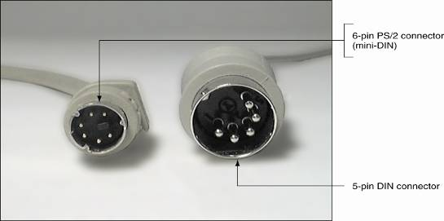
Figure 9-3 Two common keyboard connectors are the PS/2 connector and the DIN connector

Slide 11
Installing Keyboards
Typical procedure: plug in keyboard and turn on PC
BIOS manages the keyboard, no drivers are needed
Drivers are needed for a wireless keyboard
Installation procedure for wireless keyboard
Plug in the receiver
Insert the CD or floppy disk
Run the setup program on the disk

Slide 12
Cleaning the Keyboard
Particles accumulating under keys impair functions
Maintenance to perform
Routinely clean keyboard surface with a damp cloth
Turn keyboard upside down and lightly bump keys
Blow out dust and debris using compressed air
Service the key well
Remove cap on problem key with a chip extractor
Spray contact cleaner into key well of problem key
Repeatedly depress the contact to clean it

Slide 13
The Mouse and Other Pointing Devices
Pointing device
Allows you to move a pointer on the screen
Enables you to perform tasks; e.g., click a button
Common pointing devices
Mouse, trackball, touch pad
Some mice are wireless and come with key pads
Wireless connection made through a USB receiver

Slide 14
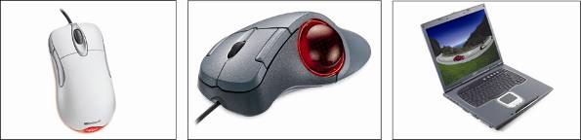
Figure 9-6 The most common pointing devices: a mouse, a trackball, and a touch pad

Slide 15
Mouse Technologies
How the wheel mouse works
Ball internal to mouse moves as you drag mouse
Two rollers are turned by the movement of the ball
Rollers represent x (horizontal) and y (vertical) position
Each roller turns a wheel, which chops a light beam
Chops encode movement, which is passed to CPU
The optical mouse
Ball replaced with microchip, laser light, and camera
Light illumines surface and camera takes snapshots
Microchip reports small changes to the PC

Slide 16
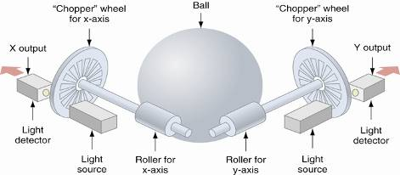
Figure 9-9 How a wheel mouse works

Slide 17
Mouse Technologies (continued)
Mouse buttons or scroll wheel are programmed
Methods used by a mouse to connect to a PC
The round PS/2 mouse port off the motherboard
Bus card
A serial port
A USB port
Y-connection with the keyboard
Cordless technology
Connection methods require varying resources
Motherboard mouse is the first choice

Slide 18
Cleaning a Mouse
Cleaning procedure
Remove the cover of the mouse ball
Use compressed air to blow out dust
Use swab dipped in liquid soap to clean the rollers
Use sticky side of duct tape clean the mouse ball
Expensive cleaning kits are usually not needed

Slide 19
Touch Screens
Uses monitor or LCD panel as backdrop for input
Senses click and drag events and sends them to CPU
Touch screen processes a touch like a mouse click
Modes of installation:
Embedded inside a monitor or LCD panel
Installed on top of a monitor or LCD panel (add-on)

Slide 20
Other Pointing Devices
Trackball
An upside-down wheel mouse
Move the ball on top to turn rollers
Rollers turn a wheel sensed by a light beam
Touch pad
Allows you to duplicate the mouse function
Move pointer by applying light pressure with one finger
Depressed pad senses the x, y movement
Buttons on the touch pad are like mouse buttons
Use touch pads or trackballs where space is limited

Slide 21
Specialty Input Devices
Include barcode readers, fingerprint readers, others
Not encountered as frequently basic I/O devices
Developing support skills
Expand support skill set for basic I/O devices
Refer to documentation to fill in the gaps

Slide 22
Barcode Readers
Scan barcodes on products
Maintains inventory or supports sale transaction
Some types of barcode readers
CCD scanner, image scanner, and laser scanner
Methods for interfacing with a PC
Wireless link, serial port, USB port, keyboard port
How a barcode reader passes information
Scans a barcode for numeric information
Software extracts company and product identification
Price lookup performed based on id input to reader

Slide 23
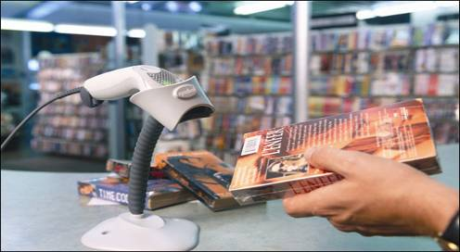
Figure 9-11 Handheld or hands-free barcode scanner by Metrologic

Slide 24
Fingerprint Readers and Other Biometric Devices
Individual’s data input to a biometric device:
Fingerprints, handprints, face, voice, eye, signatures
How a biometric device works:
Data, such as fingerprint or iris, is scanned and stored
Data subsequently scanned compared to stored data
Disadvantages: false positives or false negatives
Combine device with other authentication techniques
Run the setup CD before installing the device

Slide 25
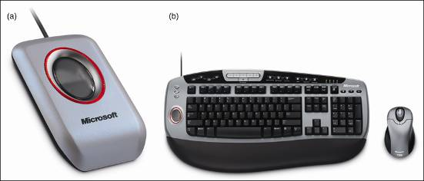
Figure 9-13 Fingerprint readers can (a) look like a mouse, but smaller, or (b) be embedded on a keyboard

Slide 26
Monitors, Projectors, and Video Cards
Monitor: the primary output device of a computer
Video card (controller, or adapter)
Interfaces monitor with motherboard components
Projector: displays video for large group of users
Projector can connect to a second video port

Slide 27
Monitors
Two categories:
CRT (cathode-ray tube)
LCD (liquid crystal display); also called flat panel
How a CRT monitor works:
Filaments shoot electron beam to front of tube
Plates direct beam to paint screen from left to right
Control grid specifies coloring of each dot on screen
Controls one of three electron guns (red, green, blue)
Modified beam strikes phosphor to produce color

Slide 28
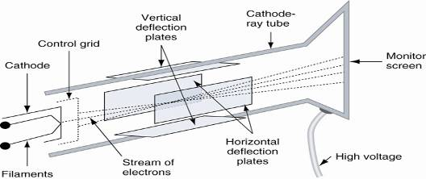
Figure 9-17 How a CRT monitor works

Slide 29
Monitors (continued)
How an LCD monitor works:
Two grids of electrodes surround center layers
Make up an electrode matrix of rows and columns
Each intersection of row and column forms a pixel
Software manipulates each pixel via electrodes
Image is formed by scanning columns and rows
Polarizer controls flow of light through pixel
Two types of LCD technology:
TFT (thin film transistor)
DSTN (dual-scan twisted nematic):

Slide 30
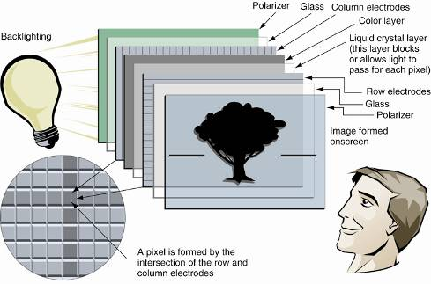
Figure 9-18 Layers of an LCD panel

Slide 31
Monitors (continued)
Comparing features of LCD and CRT monitors:
Space: LCD requires less space than CRT monitor
Power: LCD requires less electricity to operate
Expense: LCD monitors are more expensive
Refresh rate: LCD response time < CRT refresh rates
Interlacing CRT monitors draw screen in two passes
Dot pitch: distance between color dots
Resolution: measures number of addressable pixels
Example 1: XGA supports up to 1024 x 768 pixels
Example 2: SVGA supports up to 800 x 600 pixels

Slide 32
Using a Projector
Projectors display images for a large group
Example: portable XGA projector by NEC
Native resolution of XGA 1024 x 768
Connects to PC via15-pin video port or S-Video port
An extra video port is required
Desktops may need a second video card
Most notebooks provide the 15-pin video port
For notebooks, a function key activates projector

Slide 33
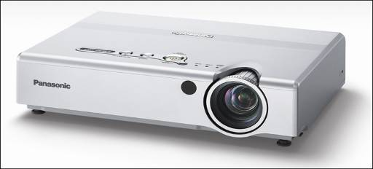
Figure 9-21 Portable XGA projector by NEC

Slide 34
Video Cards
Interface between monitor and computer
Also called graphics adapters and video boards
Five ports for five methods of data transfer:
RGB (red, green, blue) video using a VGA port
DVI (Digital Visual Interface): used by LCD monitors
Composite video: RGB mixed in the same signal
S-Video (Super-Video): sends two signals over cable
HDMI (High-Definition Multimedia Interface)
Two main features: bus used and RAM supported

Slide 35
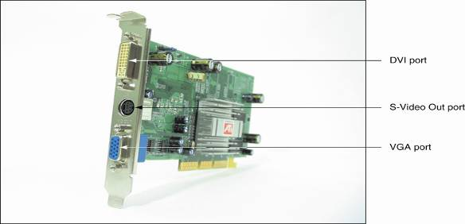
Figure 9-22 This ATI Radeon video card has three ports for video out: DVI, S-Video, and the regular VGA port

Slide 36
Video Cards (continued)
Four buses: VESA, regular PCI, AGP, PCI Express
Video cards currently use AGP and PCI Express
AGP
Performs DIME (direct memory execution)
Major AGP releases: AGP 1.0, AGP 2.0, AGP 3.0
PCI Express
PCI Express x16 is twice as fast as AGP x8
PCI Express video card has dedicated PC Express bus
Graphics accelerator: video card that has a processor

Slide 37
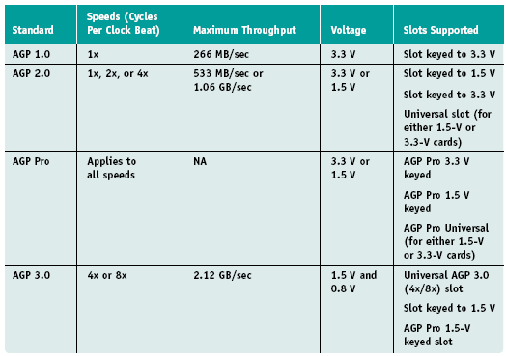
Table 9-4 AGP standards summarized

Slide 38
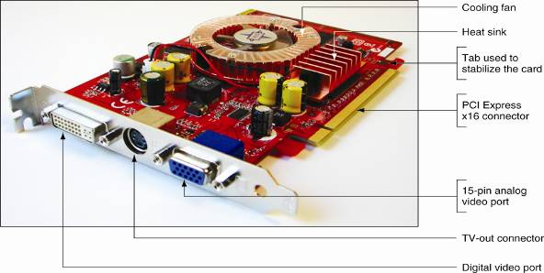
Figure 9-28 This PCX 5750 graphics card by MSI Computer Corporation uses the PCI Express x16 local bus

Slide 39
Video Cards (continued)
Video memory is stored in chips on video cards
Frame buffer: memory that specifies a screen of data
Factors affecting volume of data stored in frame buffer
Screen resolution (measured in pixels)
Color depth (number of colors measured in bits)
Alpha blending (enhancements to color information)
A few types of video memory:
VRAM (video RAM): a type of dual-ported memory
SGRAM (synchronous graphics RAM): like SDRAM
Direct RDRAM (DRDRAM): works well with streaming

Slide 40
Using Ports and Expansion Slots for Add-on Devices
Ports provided by a motherboard:
Serial, parallel, USB, FireWire, or network port
Ports provided by an expansion card:
Serial ATA, video, or SCSI
Critical criterion for evaluating a port: port speed
Skills to acquire:
How to use serial, parallel, USB, and FireWire ports
How to install expansion cards in expansion slots

Slide 41
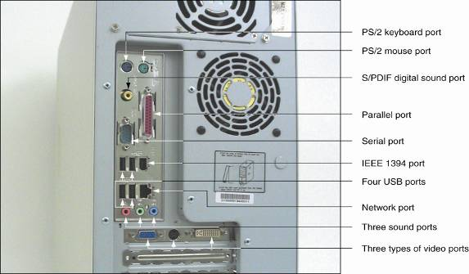
Figure 9-34 Rear of computer case showing ports; only the video ports are not coming directly off the motherboard

Slide 42
Using Serial Ports
Serial ports transmit data in single bits
Originally intended for I/O devices such as a modem
Serial ports conform to RS-232c interface standard
Maximum cable length of 50 feet
Male port originally designed for 25 pins; modified to 9
COM assignments provide IRQ and I/O addresses
COM/LTP assignments now made in CMOS setup
Port settings control serial port communication
View port settings using the Device Manager

Slide 43
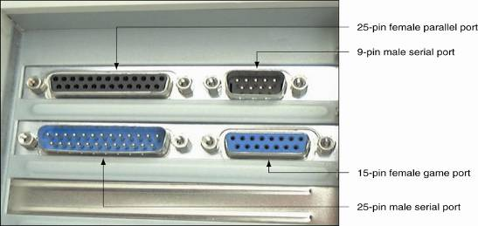
Figure 9-35 Serial, parallel, and game ports

Slide 44
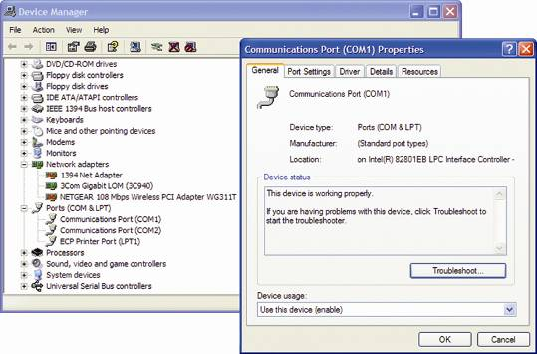
Figure 9-37 Properties of the COM1 serial port in Windows XP

Slide 45
Infrared Transceivers
Alternative terminology:
IrDA (Infrared Data Association) or IR transceiver
Provide infrared port for wireless communication
Used by wireless keyboards, mice, PDAs, printers
External type can be plugged into USB or serial port
Technology is obsolescent due to line of sight issue

Slide 46
Using Parallel Ports
Parallel ports simultaneously transmit 8 bits of data
Parallel ports are used primarily by printers
Types of parallel ports:
Standard parallel port (SPP): single-directional
EPP (Enhanced Parallel Port): bidirectional
ECP (Extended Capabilities Port): EPP plus DMA
Parallel port off board is configured in CMOS setup
Parallel port technology is being replaced by USB

Slide 47
Using USB Ports
Advantages of USB ports over parallel and serial ports
USB is much faster than regular ports
USB uses higher-quality cabling
USB is much easier to manage
USB allows for hot-swapping and hot-pluggable devices
Some USB devices: mouse, printer, scanner, modem
Connect device to USB port off board or adapter card
USB versions
USB 1.1: allows for speeds of 1.5 Mbps and 12 Mbps
USB 2.0: speeds to 480 Mbps, backward compatibility

Slide 48
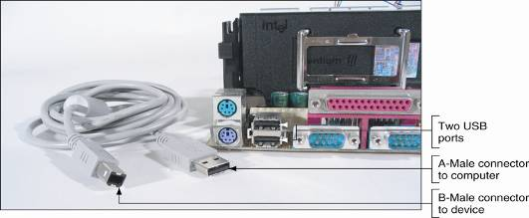
Figure 9-41 A motherboard with two USB ports and a USB cable; note the rectangular shape of the connection as compared to the nearby serial and parallel D-shaped ports

Slide 49
Using USB Ports (continued)
USB host controller
Usually included in chipset
Manages communication on USB bus
Interfaces with the CPU along a single IRQ line
USB cabling
Daisy chain up to 127 USB devices using USB cables
USB cable has two power and two communication wires
Connectors: host end is A-Male, device end is B-male
Cables for Hi-Speed USB 2.0 can be up to 5 meters
Use a hub to increase distance from device to CPU

Slide 50
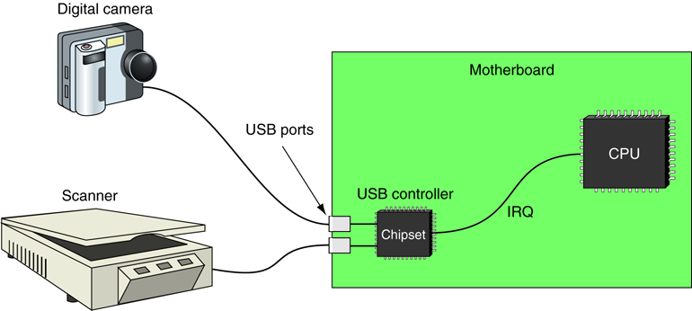
Figure 9-46 The USB controller has a single IRQ line that it uses when any USB device needs attention

Slide 51
Using USB Ports (continued)
Components needed to install a USB device:
Motherboard or expansion card providing a USB port
An OS that supports USB
A USB device
A USB device driver
Read the device documentation prior to installation
Installing a USB scanner device
1. Verify USB host controller is installed under Windows
2. Plug in the USB device
3. Install the application software to use the device

Slide 52
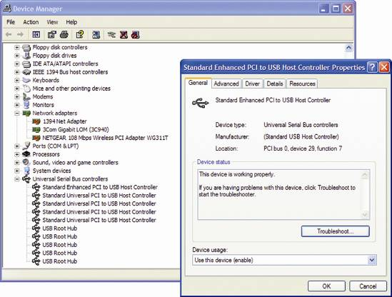
Figure 9-47 Using Device Manager, verify that the USB controller is installed and working properly

Slide 53
Using IEEE 1394 Ports
Also called FireWire or i.Link
Essential features
Uses serial transmission of data like USB (but faster)
Isochronous transmission supports real-time data flow
Easier to configure than SCSI
Devices are hot-pluggable and can be daisy chained
Host controller uses a single set of system resources
One host controller can support up to 63 devices
IEEE 1394 standards: 1394a, 1394b, 1394c(testing)
1394b (FireWire 800) supports speeds up to 3.2 Gbps

Slide 54
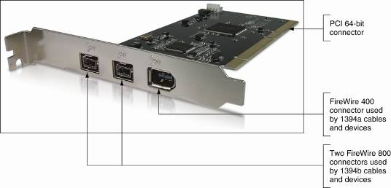
Figure 9-51 This 1394 adapter card supports both 1394a and 1394b and uses a 64-bit PCI bus connector

Slide 55
Installing and Supporting Expansion Cards
Typical slot provision on the motherboard
3 regular PCI slots and one slot for a video card
All expansion cards now use Plug and Play (PnP)
Selecting PCI cards
Be aware of the various standards
Match voltage requirements of card to slot
A 32-bit PCI card be installed in a 64-bit slot
PCI bus runs at the speed of the slowest PCI card
Modem: device interfacing PC to phone line
May be embedded component, PC card, or external

Slide 56
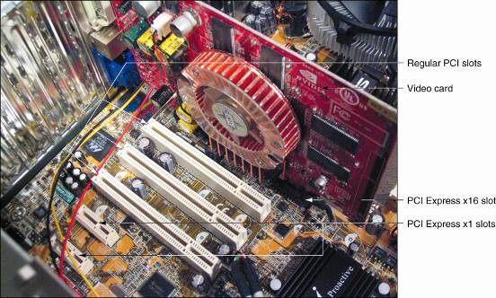
Figure 9-54 Asus P5AD2 motherboard with the MSI GeForce FX5750 video card installed in a PCI Express x16 slot

Slide 57
Installing and Supporting Expansion Cards (continued)
Overview of procedure for installing a modem card
Insert card into expansion slot
Plug telephone line from house into line jack on modem
Turn on PC to activate Plug and Play process
Follow instructions provided by Windows
Verify modem configuration using Device Manager
Test the modem
Supporting multiple PCI cards
PCI controller assigns interrupt levels to PCI cards
One IRQ line can service multiple cards

Slide 58
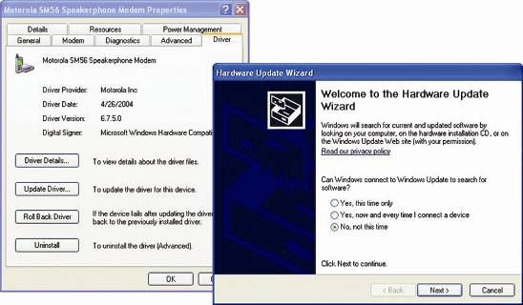
Figure 9-58 Use the Hardware Update Wizard to install the modem manufacturer drivers

Slide 59
Troubleshooting I/O Devices
General steps to follow:
1. Redo and recheck each step of the installation
2. Ask the user about recent changes in the system
3. Analyze the situation, try to isolate the problem
4. Check the simple things first; e.g., the on switch
5. Uninstall device through Device Manager, reboot
6. Exchange the device for a known working device
7. Document symptoms, source, and solution

Slide 60
Troubleshooting Keyboards
A few keys don’t work
Check the Num Lock key
The keyboard does not work at all
Check the cabling
Key continues to repeat after being released
Clean the key switch with contact cleaner
Keys produce wrong characters
If problem is due to a bad chip, replace the keyboard
Major spills on the keyboard
Try rinsing keyboard in water; reinstall after it dries

Slide 61
Troubleshooting a Touch Screen
Check the touch screen cabling
Replace a screen with excessive scratches
Clean around the edges of a touch screen
Recalibrate the touch screen
Uninstall and reinstall the touch screen

Slide 62
Troubleshooting a Mouse or Touchpad
Check the mouse port connection
Check for dust or dirt inside the mouse
Open the Control Panel Mouse applet, verify settings
Try a new mouse
Uninstall and reinstall the mouse driver

Slide 63
Troubleshooting Monitors and Video Cards
Power light (LED) does not go on; no picture
Verify that connection is tight and PC is turned on
Power light (LED) is on, no picture on power-up
Check contrast, brightness or backlight adjustment
Power light (LED) is on, wrong characters displayed
Exchange the video or motherboard
Monitor flickers, has wavy lines, or both
Check the cabling and the refresh rate
No graphics display or screen goes blank
Replace video card or add video RAM

Slide 64
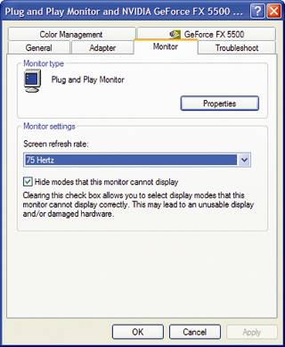
Figure 9-64 To reduce monitor flicker, increase the screen refresh rate

Slide 65
Troubleshooting Monitors and Video Cards (continued)
Screen goes blank after 30 seconds
Check configuration of power management
Poor color display
Exchange video cards or add more video RAM
Picture out of focus or out of adjustment
Check adjustment knobs or change refresh rate
Cracking sound
Trained technician should vacuum inside monitor
Display settings make the screen unreadable
Return to standard VGA settings; e.g., 640 x 480

Slide 66
Summary
I/O (input/output) devices can be internal or external
Basic input devices: keyboard, mouse, touch screens
Specialty input: barcode readers, biometric devices
Output devices: CRT monitor, LCD monitor, projector
Video card: interfaces output device with PC system

Slide 67
Summary (continued)
Graphics accelerators directly render images
Port types: serial, parallel, USB, FireWire
Serial and parallel ports are obsolescent technologies
Current port technologies: USB 2.0 and FireWire
All USB/FireWire devices are installed using PnP

